Slide 1


Mavenflix Subscription Data Analysis
-S. Pratheepa

Slide 2

Project Overview
This project analyzes Mavenflix subscription data to uncover customer trends, retention patterns, and revenue impacts. The dataset includes customer sign-ups, cancellations, subscription costs, and payment details.
By applying SQL-based analytics, the project identifies factors influencing churn, retention rates, seasonal behaviors, and financial implications of lost revenue.

Slide 3

Project Goal
The main goal of this project is to;
Understanding subscription growth and cancellation trends.
Identifying high-risk customers likely to cancel early.
Highlighting loyal customers and resubscription patterns.
Quantifying financial impact of cancellations.
Providing actionable insights for data-driven decision making.

Slide 4

Let’s Start Solving the key business questions around Mavenflix subscriptions

Slide 5
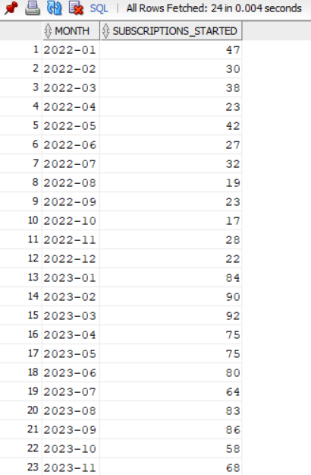
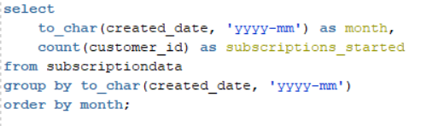
1. Subscription Trends Over Time
Monthly subscription sign-ups tracked to observe overall growth trends.
Subscriptions increased steadily over time, peaking at 92 new subscriptions in March 2023, showing overall growth from 2022 into 2023.

Slide 6
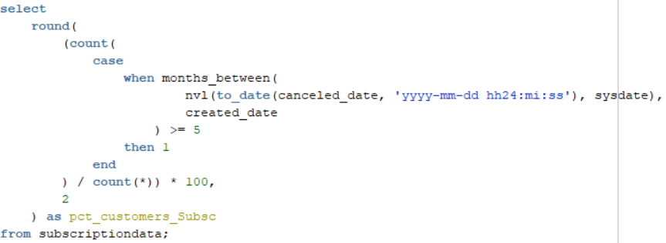
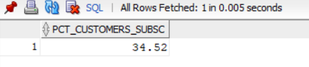
2. Long-Term Subscribers
Percentage of customers subscribed for 5+ months, indicating loyalty and engagement.
34.52% of Mavenflix customers have remained subscribed for 5 months or more.

Slide 7
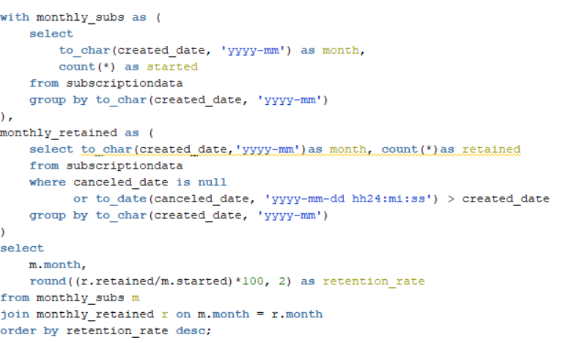
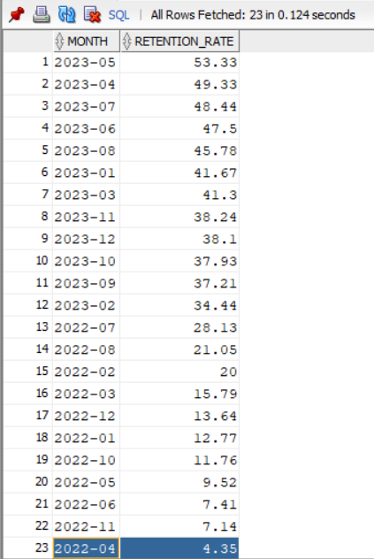
3. Subscriber Retention by Month
Identifies months with highest and lowest retention rates to track customer stickiness.
Mavenflix subscriber retention peaked in May 2023 at 53.33% and dropped to its lowest in April 2022 at 4.35%.

Slide 8
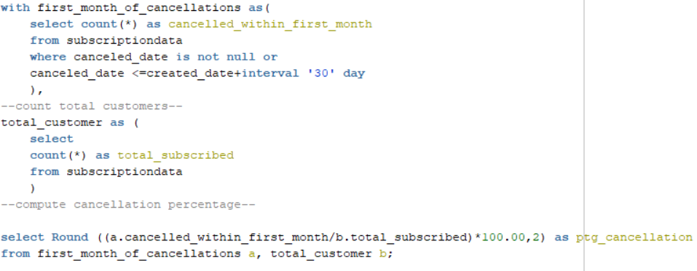
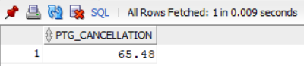
4. First-Month Cancellations
Percentage of customers canceling within 30 days of joining.
65.48% of Mavenflix customers cancel their subscription within the first month of joining.

Slide 9
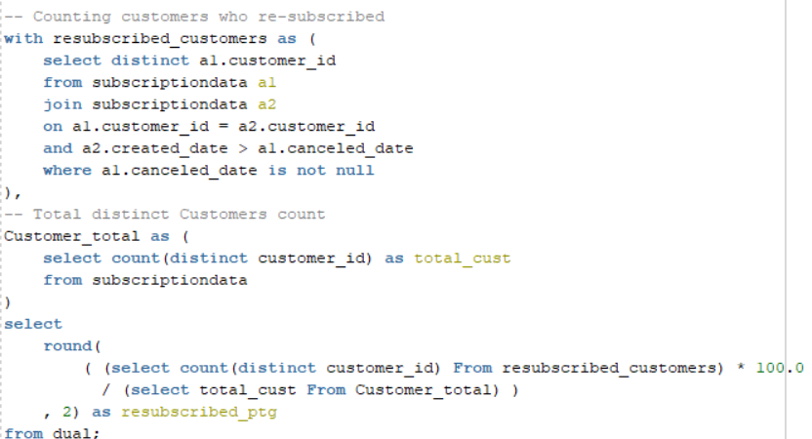
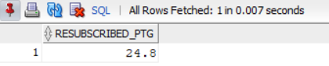
5. Re-Subscription Rate
Percentage of customers who resubscribed after canceling once, showing comeback potential.
24.8% of Mavenflix customers have re-subscribed after canceling once.

Slide 10
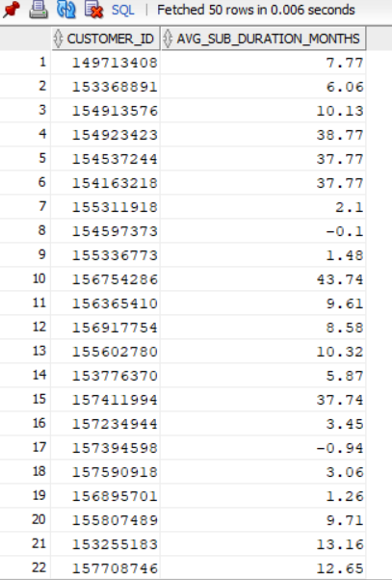
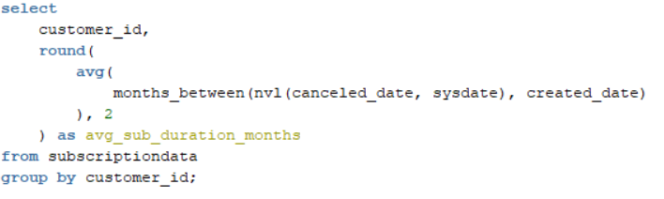
6. Average Subscription Duration
Average subscription length across customers, measured in months.
The average subscription duration Mostly ranges between 6–12 months. Some long-term users stayed over 40 months, while a few records show negative or near-zero values due to data inconsistencies.

Slide 11
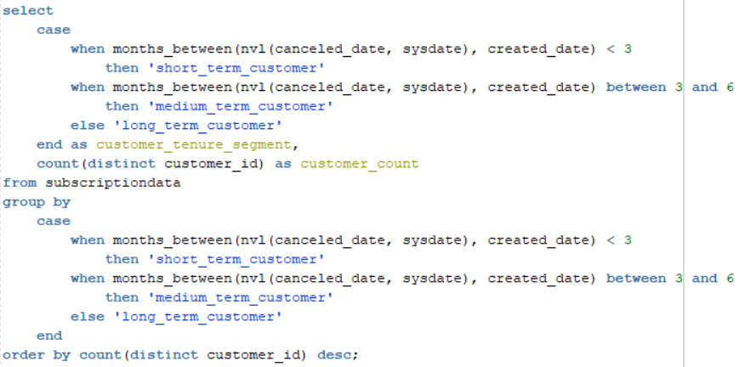
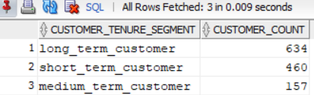
7. Customer Tenure Segmentation
Classification of customers as short, medium, or long-term subscribers.
Among Mavenflix customers, 634 are long-term, 460 are short-term, and 157 are medium-term subscribers.

Slide 12
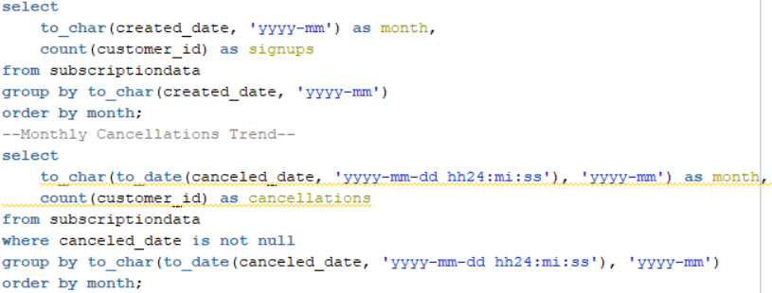
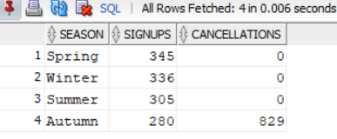
8. Seasonal Trends
Breakdown of sign-ups and cancellations by month and season.
Mavenflix sign-ups peak in Spring (345) and Winter (336), while cancellations spike in Autumn (829), indicating seasonal trends in customer behavior.

Slide 13
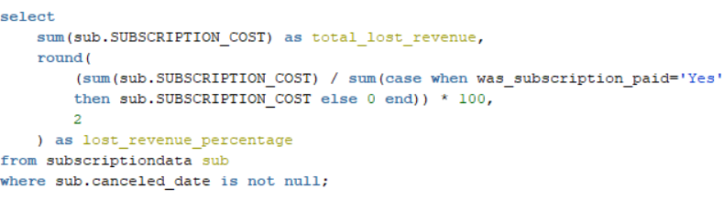
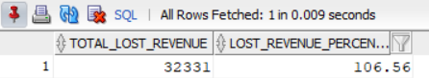
9. Lost Revenue Analysis
Total lost revenue due to cancellations and its percentage of paid revenue.
Mavenflix lost a total of 32,331 in subscription revenue due to cancellations, which accounts for 106.56% of paid subscriptions.

Slide 14
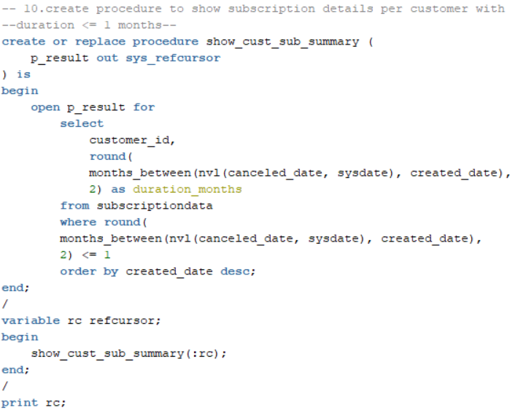
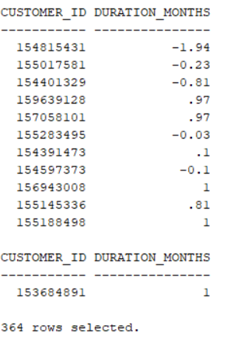
10. Short-Term Subscription Analysis
Identifying customers with subscription durations of 1 month or less.
A total of 364 Mavenflix customers have a subscription duration of 1 month or less.

Slide 15

Customer Behavior & Subscription Insights
Subscription Growth Trend: Mavenflix subscriptions increased steadily, peaking at 92 new subscriptions in March 2023, indicating strong growth over time.
Long-Term Subscribers: 34.52% of customers remain subscribed for 5 months or more, highlighting customer loyalty.
Monthly Retention Rates: Retention peaked in May 2023 at 53.33% and dropped to its lowest in April 2022 at 4.35%, showing seasonal variability.
First-Month Cancellations: 65.48% of customers cancel within the first month, indicating a need for better onboarding and engagement.
Re-Subscription Rate: Only 24.8% of customers re-subscribe after canceling, showing limited return behavior.

Slide 16
Financial & Seasonal Insights
Average Subscription Duration: Most customers stay between 6–12 months, while some long-term users remain over 40 months; a few records show negative/near-zero durations due to data inconsistencies.
Customer Tenure Segmentation: 634 long-term, 460 short-term, and 157 medium-term customers, providing insight into user lifecycle distribution.
Seasonal Sign-Ups & Cancellations: Sign-ups peak in Spring (345) and Winter (336), while cancellations spike in Autumn (829), highlighting seasonal trends.
Lost Revenue Impact: Mavenflix lost 32,331 in subscription revenue due to cancellations, accounting for 106.56% of paid subscriptions, emphasizing financial impact.

Slide 17

Conclusion
The Mavenflix subscription analysis reveals significant trends in customer behavior, retention, and churn patterns. High first-month cancellations and limited re-subscriptions indicate areas for improved onboarding and engagement strategies. Seasonal spikes in sign-ups and revenue losses due to cancellations highlight the need for targeted marketing and retention efforts. Overall, these insights provide actionable guidance to enhance customer loyalty, optimize revenue, and drive sustainable growth.

Slide 18
Thank You

